Slide 1
News Article Summarization using RNNs
Ayush Bhagta IIT2019501
Md Monish IIB2019033
Sanket Kokude IIB2019034
Harshit Kumar IIB2019035
Viful Niarala IIB2019036

Slide 2
INTRODUCTION
Summarization is the task of producing concise and fluent summary while preserving the main ideas of text. NLP models are now able to extract information from input texts. There are two broad approaches to summarization -
Extractive Summarization
Abstractive Summarization

Slide 3
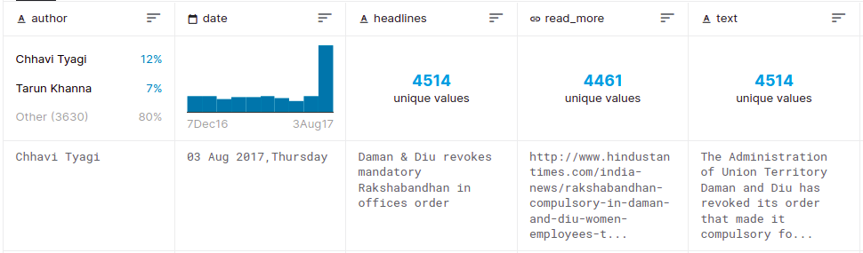
PROBLEM STATEMENT & DATASET
Given a news article, generate one-sentence summarization that mimics the style of news titles.
Dataset: News Summary Dataset Kaggle.

Slide 4
PROPOSED METHODOLOGY

Slide 5
Pre-Processing
We will perform the below preprocessing tasks for our data:
1.Convert everything to lowercase
2.Remove HTML tags
3.Contraction mapping
4.Remove (‘s)
5.Remove any text inside the parenthesis ( )
6.Eliminate punctuations and special characters
7.Remove stopwords
8.Remove short words

Slide 6
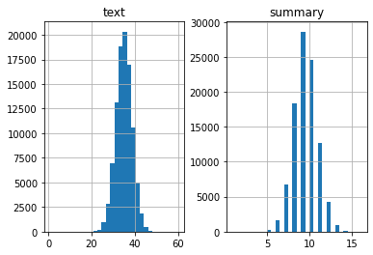
Analyzing and Preparing the Data
We will analyze the length of the reviews and the summary to get an overall idea about the distribution of length of the text to fix the maximum length of the sequence
We observe that 98.8% of the summaries have length below 12. So, we can fix maximum length of summary to 12.
Let us fix the maximum length of article to 50

Slide 7
Text Tokenizer
After preprocessing ,Now we convert the text into numerical values with the help of tokenizer in order to make them ready to feed into our neural network.A tokenizer builds the vocabulary and converts a word sequence to an integer sequence.
The tokenizer will include the first num_words-1 words appearing in the corpus. Here num_words-1 words. The most frequent num_words-1 words will be encoded, if they are more than this number they will go OOV (Out Of Vocabulary).
The maximum number of words to keep, based on word frequency. Only the most common num_words-1 words will be kept.

Slide 8
Before tokenization we need to remove rare words.
Some of the words that are very unique in nature like names, brands, product names, and some of the noise characters, such as html leftouts, also need to be removed for different NLP tasks.
We choose threshold for rare word and find the rare words count so that we can ignore these rare words.

Slide 9
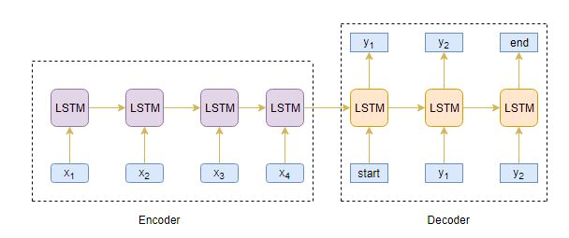
ENCODER-DECODER ARCHITECTURE

Slide 10
Sequence-to-Sequence Modeling
A sequence-to-sequence model is applied to deal with sequential information. In this problem we are trying to transform a sequence of words to another sequence of words which comes under many-to-many sequence transformation problem.
The model consist of two major blocks -
Encoder
Decoder

Slide 11
Model Building
We are building model with encoder-decoder architecture having global attention (Bahadau attention model).
Encoder contains a embedding layer, followed by 3 stacked LSTM layers one after another.
Decoder also contains a embedding layer followed by LSTM layers and a Dense layer.
Global Attention layer is there which takes in encoder outputs and decoder outputs.
We are using sparse categorical cross-entropy as the loss function since it converts the integer sequence to a one-hot vector.

Slide 12
__________________________________________________________________________________________________
Layer (type) Output Shape Param # Connected to
=======================================================================================
input_1 (InputLayer) [(None, 42)] 0 []
embedding (Embedding) (None, 42, 500) 15248500 ['input_1[0][0]']
lstm (LSTM) [(None, 42, 500), 2002000 ['embedding[0][0]']
(None, 500),
(None, 500)]
lstm_1 (LSTM) [(None, 42, 500), 2002000 ['lstm[0][0]']
(None, 500),
(None, 500)]
lstm_2 (LSTM) [(None, 42, 500), 2002000 ['lstm_1[0][0]']
(None, 500),
(None, 500)]

Slide 13
Layer (type) Output Shape Param # Connected to
======================================================================================
input_2 (InputLayer) [(None, None)] 0 []
embedding_1 (Embedding) (None, None, 500) 5425500 ['input_2[0][0]']
lstm_3 (LSTM) [(None, None, 500), 2002000 ['embedding_1[0][0]',
(None, 500), 'lstm_2[0][1]',
(None, 500)] 'lstm_2[0][2]']
attention_layer (AttentionLaye ((None, None, 500), 500500 ['lstm_2[0][0]',
r) (None, None, 42)) 'lstm_3[0][0]']
concat_layer (Concatenate) (None, None, 1000) 0 ['lstm_3[0][0]',
'attention_layer[0][0]']
time_distributed (TimeDistribu (None, None, 10851) 10861851 ['concat_layer[0][0]']
ted)

Slide 14
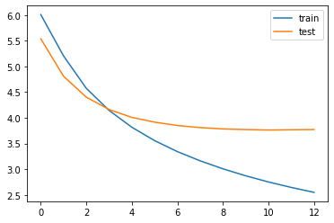
Training the Model
We are using early stopping to monitor the validation loss metric. Our model will stop training if the validation loss starts increasing.
We’ll train the model on a batch size of
128 and validate it on the holdout set
(which is 10% of our dataset)

Slide 15
Attention
Encoder outputs the encoded vector which captures the information of all the input sequence. There is a Information Bottleneck here because we are trying to compress all the input text into this vector, to overcome this problem Attention is used to increase the importance of specific parts.
There are 2 different classes of attention -
Global Attention
Local Attention

Slide 16
Attention Layer
If the length of summary exceeds 20 words then the accuracy sharply decreases. In order to fix this we use a global attention layer to fix the problem of vanishing gradient.
Attention layer takes the inputs from encoders and decoders and input.
Attention layer performs 3 tasks:
a)Alignment
b)SoftMax Calculation
c)Context Vector Calculation
It then modifies the weights for better accuracy.

Slide 17
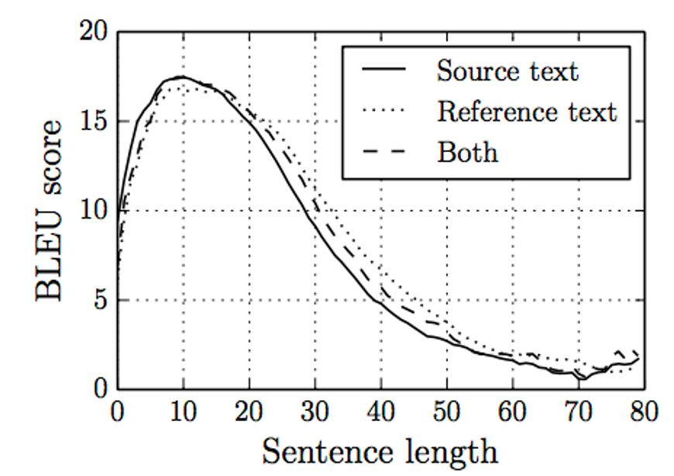

Slide 22
EVALUATION STRATEGIES
We have used two metrics to evaluate our model -BLEU & ROUGE (ROUGE-1 and ROUGE-L)
BLEU : Bilingual Evaluation Understudy Score is a language independent and widely adopted metric for evaluating a generated sentence to a reference sentence. BLEU is similar to unigram precision, the only modification in BLEU is that for word in the generates text, BLEU takes its maximum count in reference text. In practice, using unigrams/separate words isn’t optimal so BLEU instead computes precision using n-grams of the word.

Slide 23
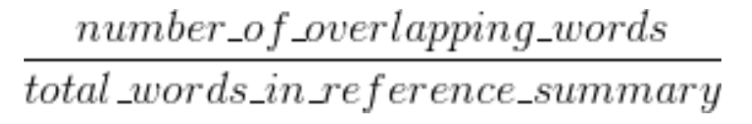
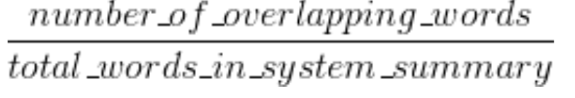

Rogue 1 recall:
Rogue 1 precision:
Finally F1-score is calculated to measure the performance of the model.
ROUGE-L measures the longest common subsequence (LCS) between our model output and reference. All this means is that we count the longest sequence of tokens that is shared between both.
Rogue 1 f1-score of our model is 62%.
Notes:
Add rogue1 accuracy:62%

Slide 24
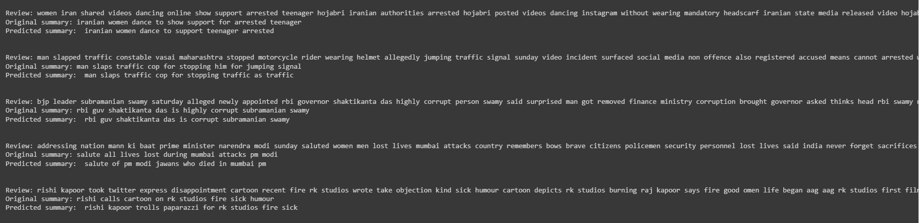
RESULTS

Slide 25
IMPROVEMENTS
Improvements in our existing work -
We can use larger dataset for better results such as Signal Media News Articles Dataset.
We can train a larger model on larger dataset to obtain better accuracy.
Using Beam Search Strategy in Inference.
We can use pre-trained state of art models such as Transformers.

Slide 26
THANK YOU!

